Slide 1
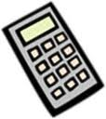
Calculator Gurus
Z
Learning Objectives
Identify the location and use of different function buttons on your scientific calculator (G-A*)
Use your calculator to perform calculations efficiently (G-A*)
Starter: Memory Test
In your table group, work together to memorise
all the buttons on your graphical calculators
In 5 minutes time you will be asked to label
all the buttons on a blank pictures of a calculator
GCSE Shape

Slide 2
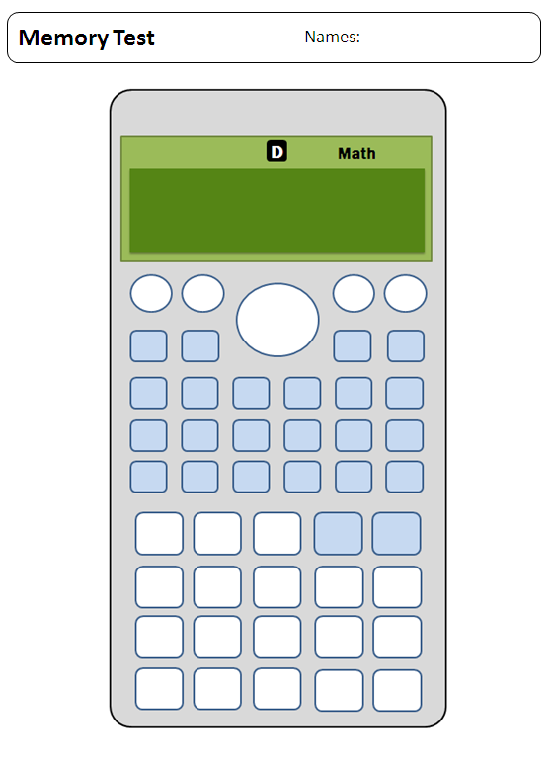
Z
Starter: Memory Test
Place all calculators face down on the floor under your desk
Working together, label as many buttons as possible on your sheet
Label as many of the shift functions as you can remember

Slide 3
Z
Getting to know your Calculator
Working in pairs, answer the questions on the sheet
Both parts of the worksheet ask you to locate buttons using co-ordinates
(3,4)
For part A you need to look at the Number Buttons at the bottom of your calculator
For part B you need to look at the function buttons higher up the calculator
(6,3)

Slide 4
Z
Your Calculator Mode: Are you Exam Ready?
Math
This is how your screen should look
D
Angles are in Degrees
Gives us simple to read answers
Follow these steps to remove any…
R
Will give wrong answers for angles
Make sure NONE of these are on your screen
G
SHIFT
MODE
3
M
There is something stored in Memory
SHIFT
9
2
STAT
Input screen will look strange
MODE
1
FIX
SCI
Answers will be in strange formats
SHIFT
MODE
8
1

Slide 5
Z
Calculator Guru Pack
Now its time for YOU to become a
GURU at using your calculator
Being able to use your calculator effectively
and efficiently will help you be able to answer
more exam questions, quicker – improving your Grade
Work individually through this pack, following the instructions as you go
D
Where you see this, refer back to the page 2 on how to get decimal answers
Name:
Class:
Teacher:
Q)
Where you see this, answer the question(s) writing your answer on the line provided
E
These are extension questions, tackle these if you are aiming for Higher GCSE Grades
1

Slide 6
Z
Switching Off!
Getting Decimal Answers
Your calculator will automatically switch off after 10 minutes
To make your battery last longer switch it off yourself…
Check now that you can switch your calculator on and off
If you get answers like these:
Change them into decimals using this button:
You will need to remember to use this button for a number of calculations, look out for
5
6
√2
3π
S⬄D
SHIFT
AC
0.833..
1.414..
9.424..
D
2

Slide 7
Z
Finding Percentages %
Using Pi π
You can find a percentage of an amount using the % function
Find 14% of 50 by typing..
Check that you get:
Q) What is 29% of 25?
You can use the π for work with circles (circumference & area)
To calculate the circumference of a circle radius 4 type..
Check that you get:
Q) What is the circumference of a
circle with radius 5m?
C = 2πr
A = πr²
1
4
SHIFT
(
X
5
0
2
SHIFT
x10^{x}
X
4
14%x50
2πx4
7
D
25.13274123
3

Slide 8
Z
BIDMAS on the Calculator
Using Brackets ( )
Type the following calculation into your calculator:
Check that you get this:
Q) Does your calculator know the
rules of BIDMAS?
Give another calculation to
prove this:
Type the following calculation into your calculator:
Check that you get this:
Q) Using your calculator decide
where you should put brackets
to make this calculation work..
5
+
2
X
6
(
5
+
2
)
X
6
5+2x6
(5+2)x6
17
42
E
10 ÷ 2 + 3 x 6 - 2 = 10
4

Slide 9
Z
Squared Numbers ²
Square Roots √
The square of a number is the number multiplied by itself
Your calculator has a button for doing this quickly:
Find the square of 17 by typing..
Check that you get:
Q) What is 2.5²?
Your calculator also has a button for finding the square root of a number:
Find the square root of 300 by typing..
Check that you get:
Q) What is √56?
√■
x²
√■
3
0
0
1
7
x²
√300
17²
D
17.32050808
289
5

Slide 10
Z
Cubed Numbers ³
Cubed Roots ³√
The cube of a number is the number multiplied by itself twice
Your calculator has a button for doing this quickly:
Find the cube of 17 by typing..
Check that you get:
Q) What is 2.5³?
Your calculator also has a shift function for finding the square root of a number:
Find the cubed root of 3 by typing..
Check that you get:
Q) What is ³√56?
³√■
x³
SHIFT
√■
3
1
7
x³
³√3
17³
1.44224957
4913
6

Slide 11
Z
Different Powers
Different Roots
You can use your calculator to find any power of a number, using this button:
Find 12 to the power of 5 by typing..
Check that you get:
Q) What is 2.5¹¹?
What is 14^{1/2} ?
There is a shift function to find any root of a number:
Find the 5th root of 30 by typing..
Check that you get:
Q) What is ⁴√56?
■√□
x■
□√□
SHIFT
x■
to get this:
then type in to get:
⁵√□
5
1
2
x■
5
and use to get to the 2nd
empty box and type in
REPLAY
3
0
12⁵
248832
⁵√30
1.974350486
E
7

Slide 12
Z
Basic Fractions
Mixed Number Fractions
Your calculator has button for entering fractions:
To enter the fraction type..
Check that you get:
Q) What is as a decimal?
What is x as a fraction?
There is a shift function enter mixed number fractions:
To enter the fraction 2 type:
Check that you get:
Q) What is 3 as a decimal?
5
5
6
6
5
to get this:
5
SHIFT
to get this:
□
□
2
2
□
and use to get to the
2nd empty box and type in
and use to get to the
2nd and 3rd empty boxes where
you can type in and
REPLAY
REPLAY
6
5
6
5
6
.
D
0.83
5
2
6
.
D
2.83
2
7
E
2
2
2
7
7
9
8

Slide 13
Z
Negative Numbers
Using the Ans Button
You should input negative numbers into your calculator using:
To enter -4 x -2 type..
Check that you get:
Q) What is -5.4 x -2.1?
Calculate -4²?
The Ans button can be used to put an answer you have just found back into your next calculation
Start by calculating 5² – 6
If x = 5² – 6, calculate x² – x
Type in:
Check that you get:
If x = 2² + 3, what’s x² – x?
(-)
Ans
(-)
4
X
(-)
2
-4x-2
Ans
x²
-
Ans
8
Ans² - Ans
342
E
NB. Use brackets!
E
9

Slide 14
Z
Standard Form
Recurring Decimals
Your calculator can convert standard form numbers into normal numbers
To convert 6 x 10⁵ type..
Check that you get:
Q) What is 2.8x10⁻²?
What is 2.8x10⁻² x 7.2x10⁵?
There is a shift function to input recurring decimals:
To input 5.612 type..
Check that you get:
You will need to press
twice to get this answer
Q) What is 2.6 x 1.2?
.
.
5
.
SHIFT
x²
6
6
x10^{x}
5
1
SHIFT
x²
2
6x105
.
.
5.612
600000
5.612612613
S⬄D
E
.
10

Slide 15
Z
Trigonometry Ratios
Inverse Trig. Ratios
E
E
You will use your calculator when working with trigonometric ratios for Higher GCSE
To calculate sin 30⁰ type..
Check that you get:
Q) What is cos30⁰?
Q) What is 5tan45⁰?
There are shift functions to calculate the inverse of trigonometric ratios
To calculate sin⁻¹0.5 type..
Check that you get:
Q) What is cos⁻¹0.5?
Calculate e if cos e = 0.23
SIN
3
0
SHIFT
SIN
0
.
5
sin(30
sin⁻¹(0.5
D
0.5
30
E
11

Slide 16
Z
Your Calculator Mode: Are you Exam Ready?
Math
This is how your screen should look
D
Angles are in Degrees
Gives us simple to read answers
Follow these steps to remove any…
R
Will give wrong answers for angles
Make sure NONE of these are on your screen
G
SHIFT
MODE
3
M
There is something stored in Memory
SHIFT
9
2
STAT
Input screen will look strange
MODE
1
FIX
SCI
Answers will be in strange formats
SHIFT
MODE
8
1
12

Slide 17
Z
Plenary: Finding the Ultimate Calculator Guru
Put away all calculators and papers from today’s lesson
Working together, label as many buttons and shift functions as possible on your sheet
Can you improve on your score for the starter?

Slide 18
Z
Review Learning Objective
Identify the location and use of different function buttons on your scientific calculator (G-A*)
Use your calculator to perform calculations efficiently (G-A*)
How did you do?

Slide 19
Topic | Page | Answers
Finding Percentages | 3 | 7.25
Using Pi | 3 | 31.415..
BIDMAS on the Calculator | 4 | Yes | Any calc requiring BIDMAS & answer
Using Brackets | 4 | 10 ÷ (2 + 3) x 6 - 2 = 10
Squared Numbers | 5 | 6.25
Square Roots | 5 | 7.483…
Cubed Numbers | 6 | 15.625
Cubed Roots | 6 | 3.825..
Different Powers | 7 | 23841.857.. | 3.741…
Different Roots | 7 | 2.735..
Basic Fractions | 8 | 0.285714 | 4/49
Mixed Number Fractions | 8 | 3.2
Negative Numbers | 9 | 11.34 | 16
Using the Ans Button | 9 | 42
Standard Form | 10 | 0.028 | 20160
Recurring Decimals | 10 | 3.2
Trigonometry Ratios | 11 | 0.866.. | 5
Inverse Trig. Ratios | 11 | 60 | 76.702..
Guru Pack: Answers
.
.
.

